Slide 1



IT HELP DESK ANALYSIS
View in Power BI
Last data refresh:
8/15/2023 1:58:48 PM UTC
Downloaded at:
8/16/2023 8:12:07 AM UTC

Slide 2
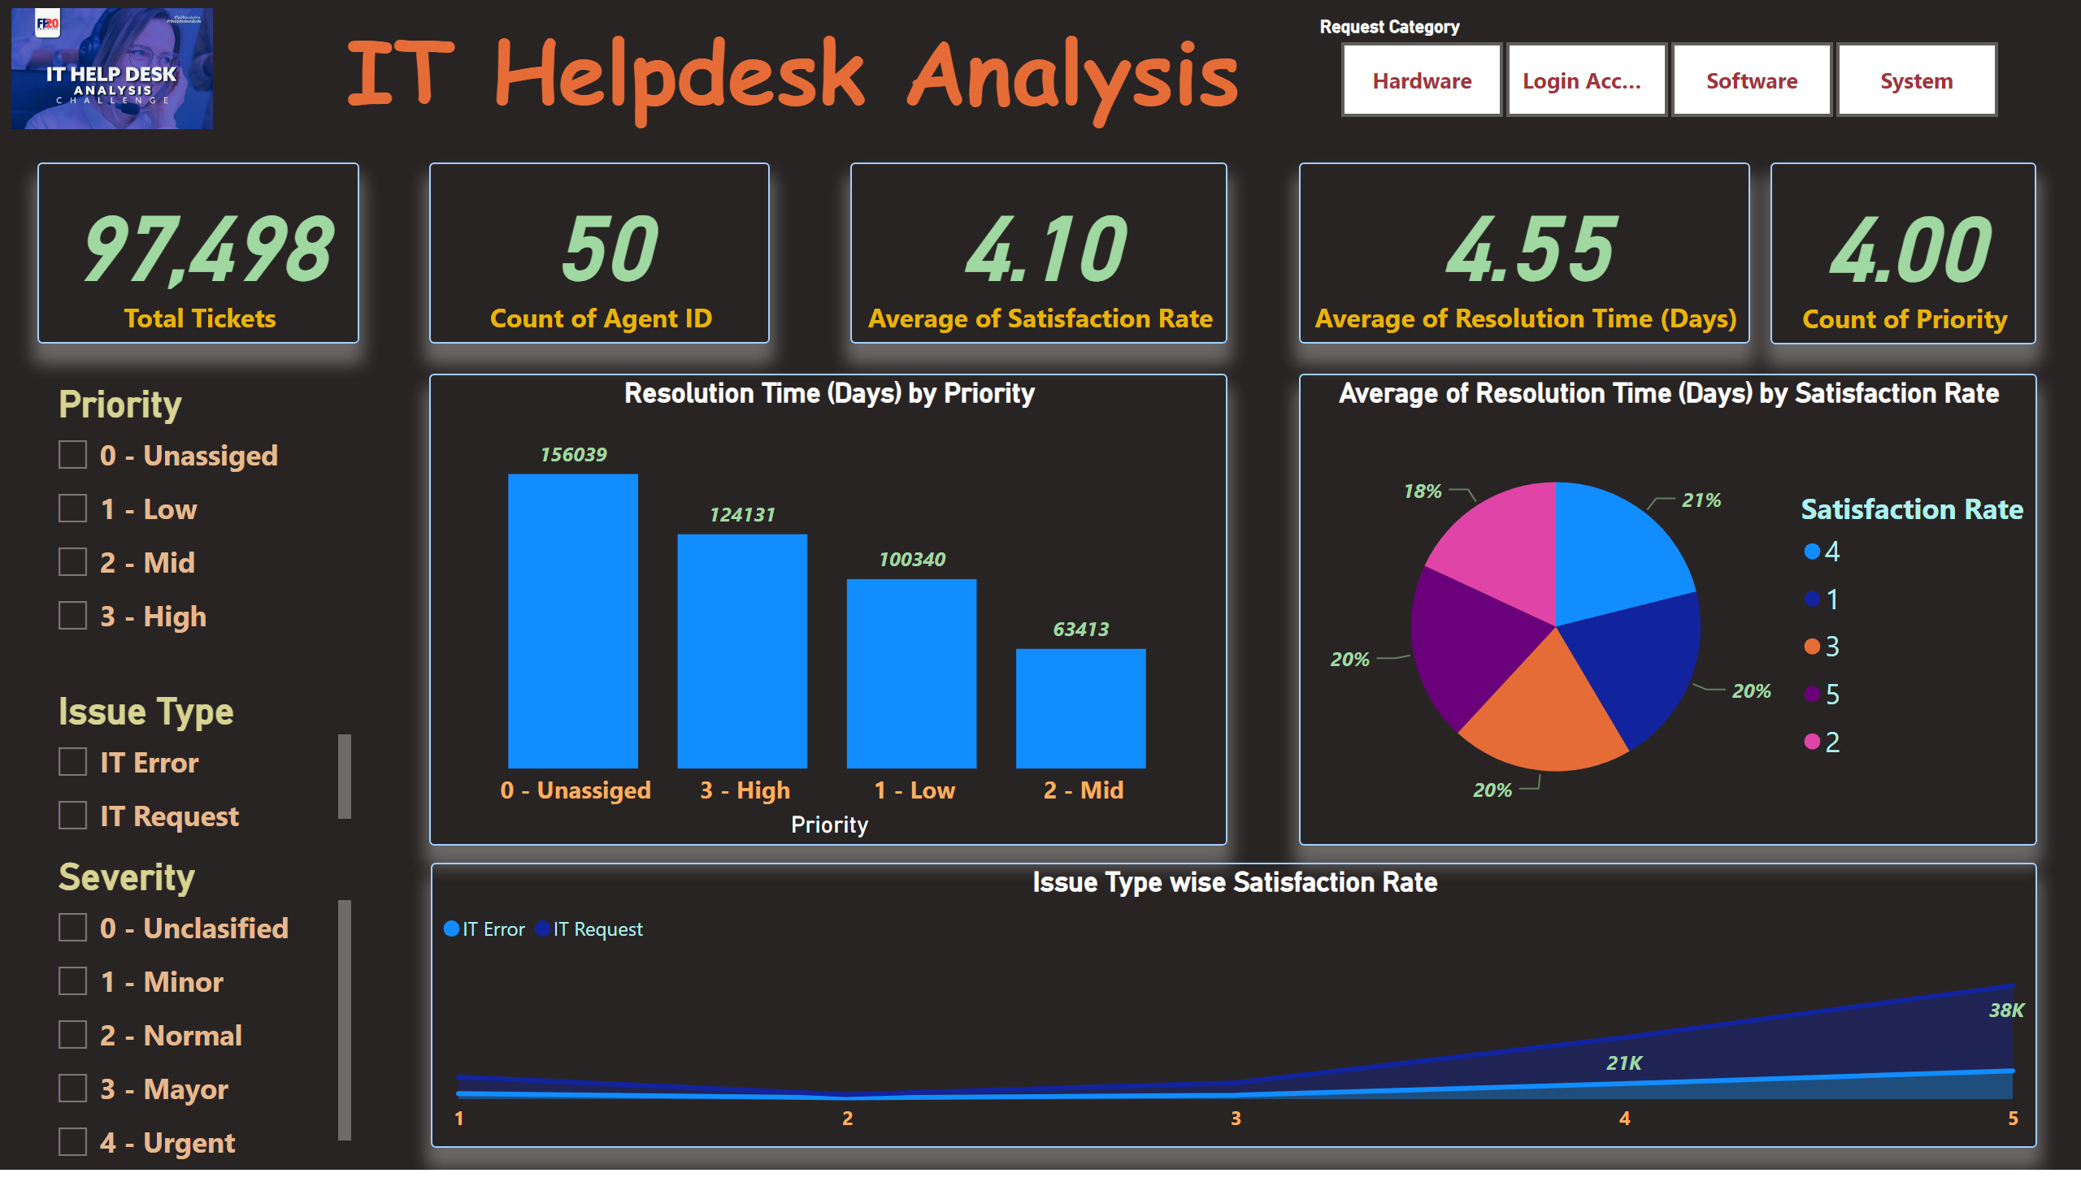
Page 1
Notes:
Issue Type wise Satisfaction Rate
No alt text provided
card
No alt text provided
slicer
No alt text provided
image
No alt text provided
pieChart
No alt text provided
Resolution Time (Days) by Priority
No alt text provided
slicer
No alt text provided
slicer
No alt text provided
slicer
No alt text provided
card
No alt text provided
card
No alt text provided
card
No alt text provided
card
No alt text provided
textbox
No alt text provided

Slide 3
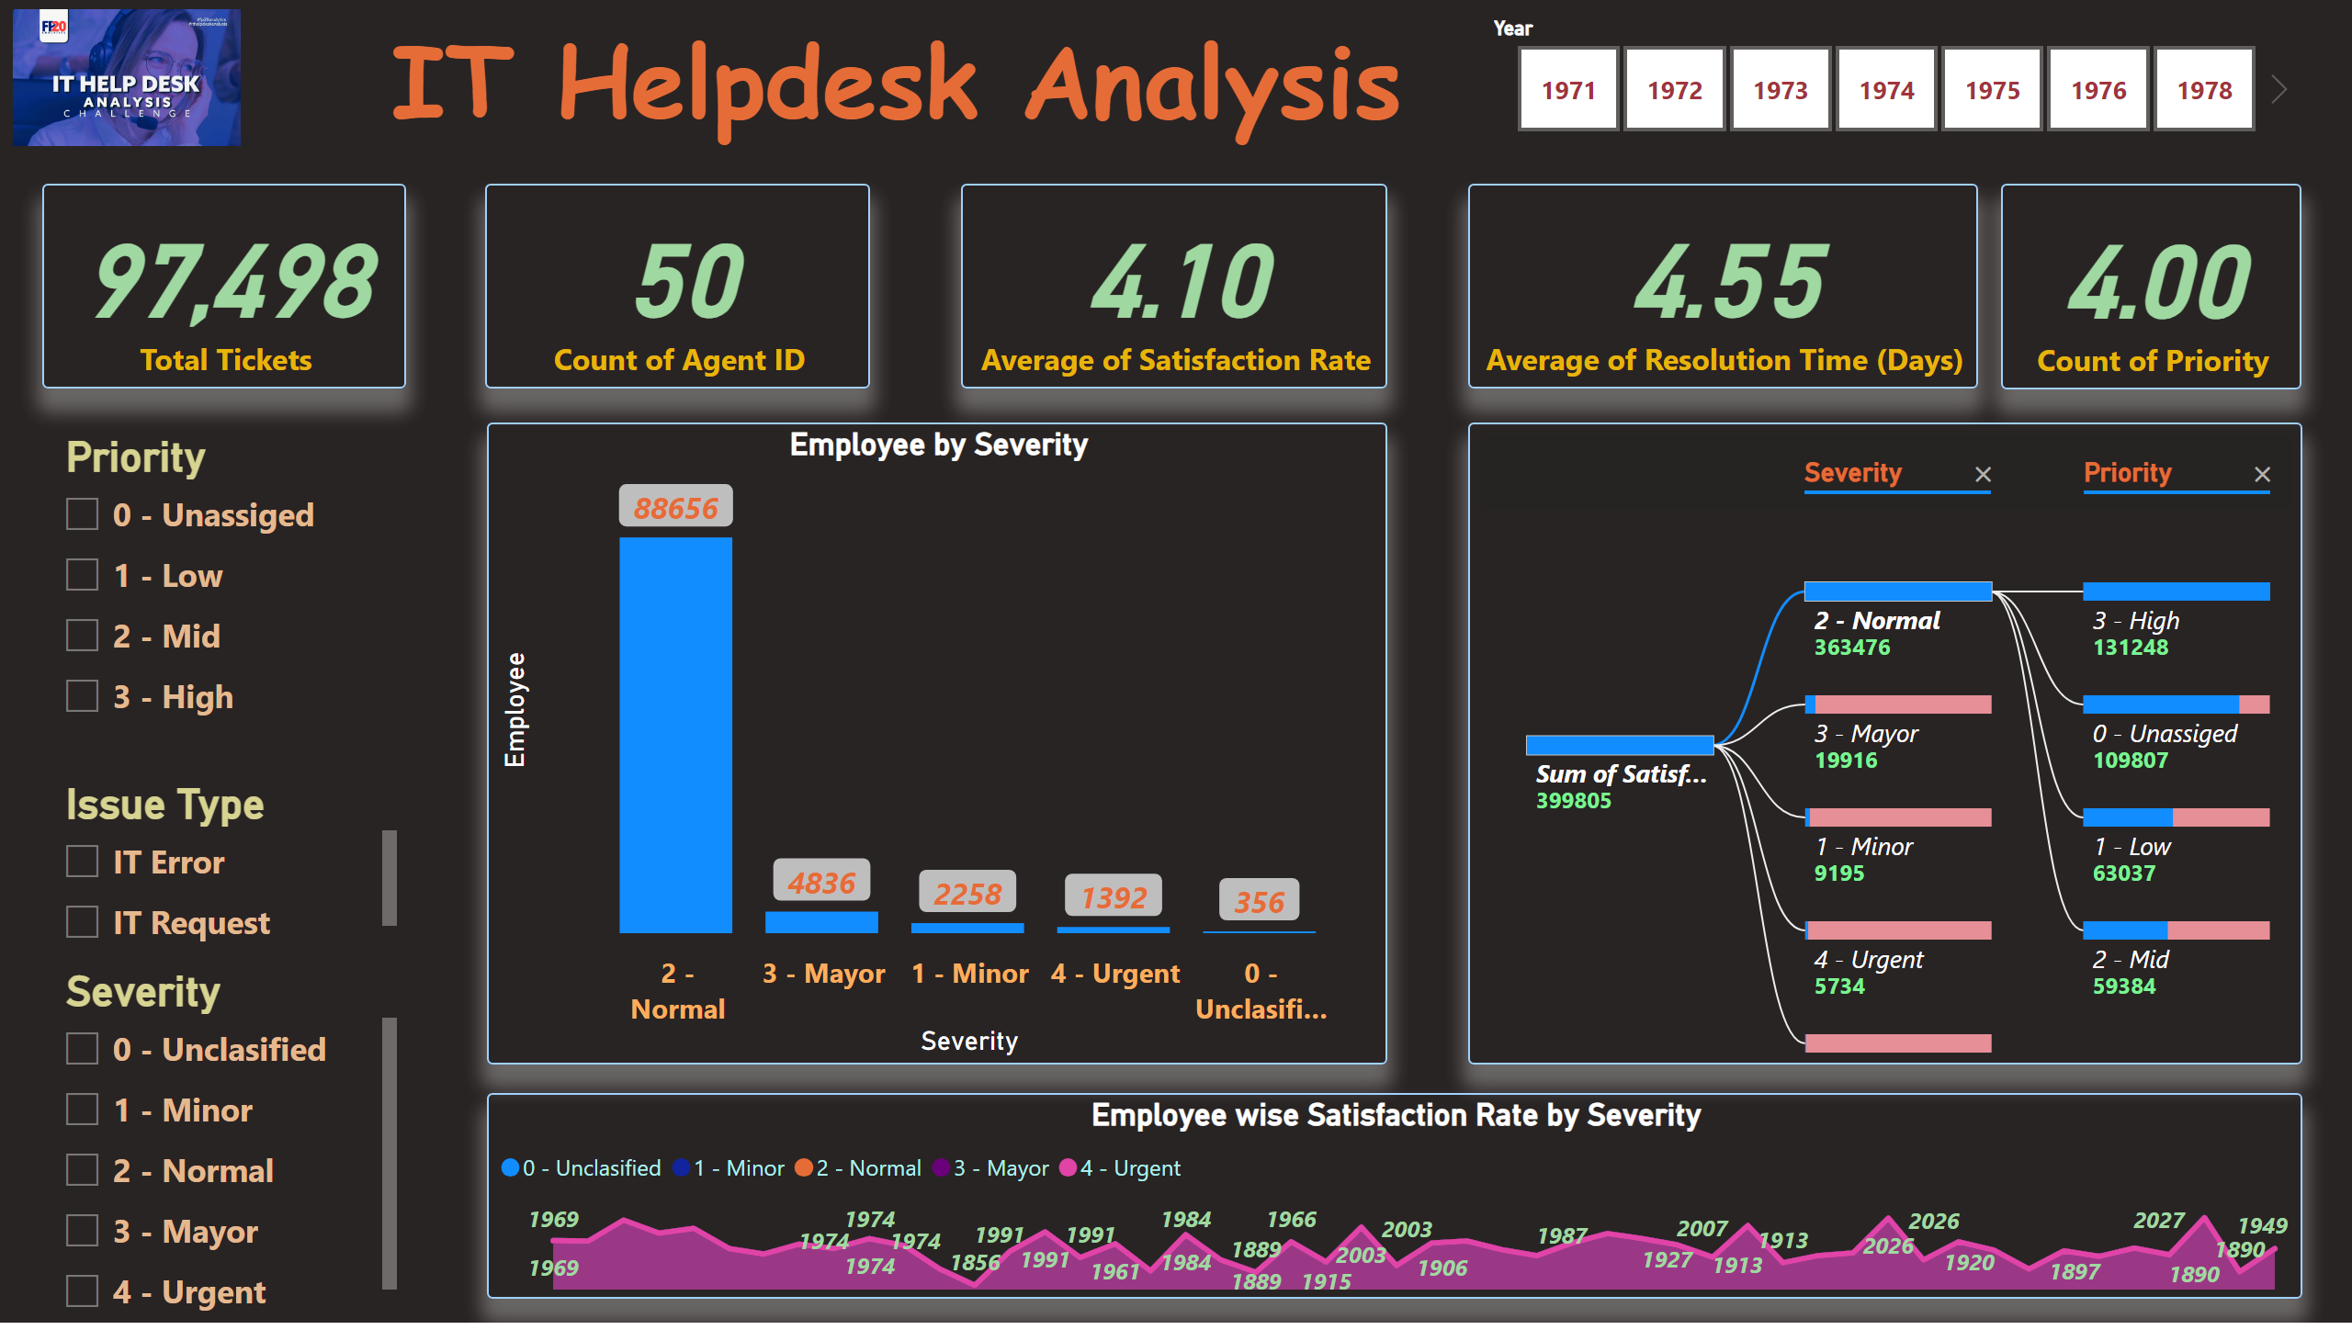
Page 2
Notes:
textbox
No alt text provided
card
No alt text provided
card
No alt text provided
card
No alt text provided
card
No alt text provided
slicer
No alt text provided
slicer
No alt text provided
slicer
No alt text provided
image
No alt text provided
slicer
No alt text provided
card
No alt text provided
lineStackedColumnComboChart
No alt text provided
decompositionTreeVisual
No alt text provided
Employee wise Satisfaction Rate by Severity
No alt text provided

